Slide 1
High efficient organic solar cells
Project number: p-2022-084.
Students: Omri Nidam , Ben Shahak.
Advisers: Prof. Shikler Rafi & Dr. Sivan Linda.

Slide 2
Background
Challenges
The main problem in OSC is the low PCE of solar energy to electrical energy.
The absorption spectra are very narrow and restricted to the visible optical spectrum only.
The abilities of the cell to create free charge.
Project purpose
The project purpose is to create an OSC with high efficiency.

Slide 3
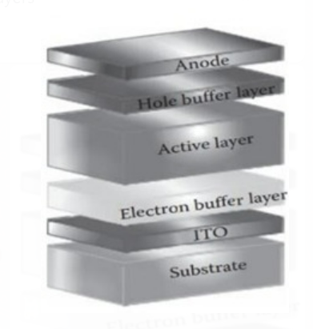
Objectives
To get maximum of light spectrum absorption.
Achieve OSC with power cell efficiency around 13%.
Project system
The organic solar cell is composed from serval layers that are build on top of each other when each layer has a unique role.

Slide 4
Aluminum
Anode
Hole buffer layer
PFN-Br
Combine of three materials:
IT-4CL, IT-2CL, PDBD-T-2F(PM6)
Active layer
Electron buffer layer
PEDOT:PSS
ITO
Cathode
Substrate
Glass

Slide 5
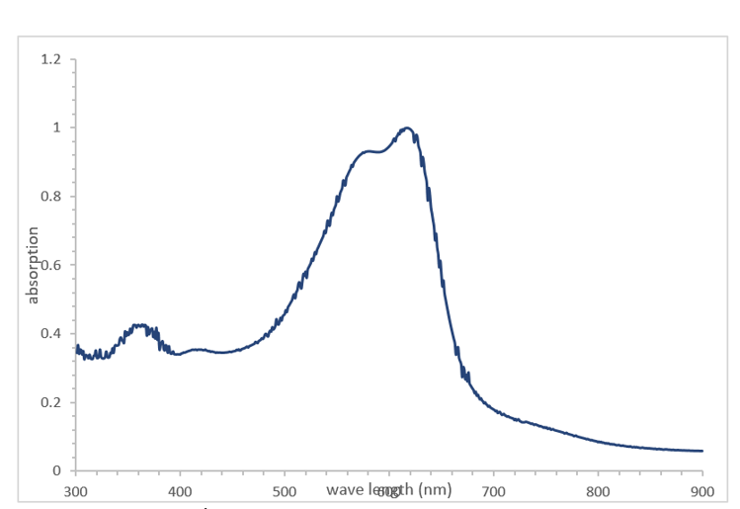
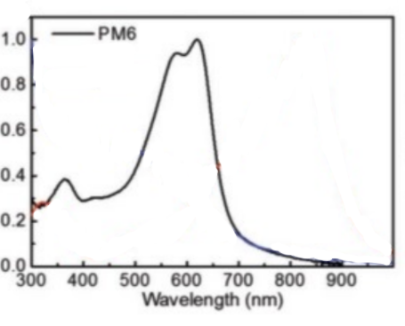
Absorption measurement
Measurement of the absorption of the active layer for each of the materials (PDBD-T-2F, ITIC-4CL/ ITIC-2CL).
As we can see, we got nearly the same plots like our reference article:
PDBD-T-2F(PM6):

Slide 6
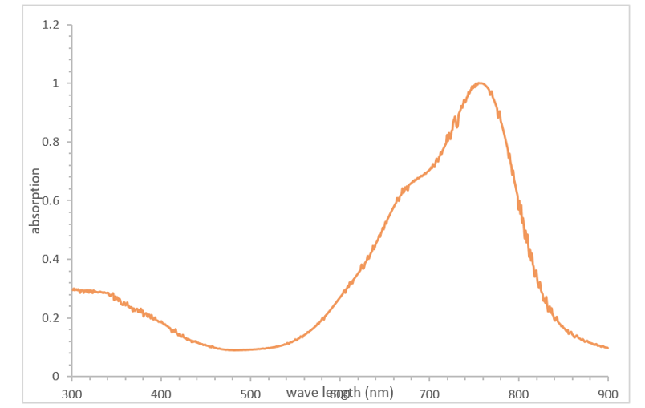
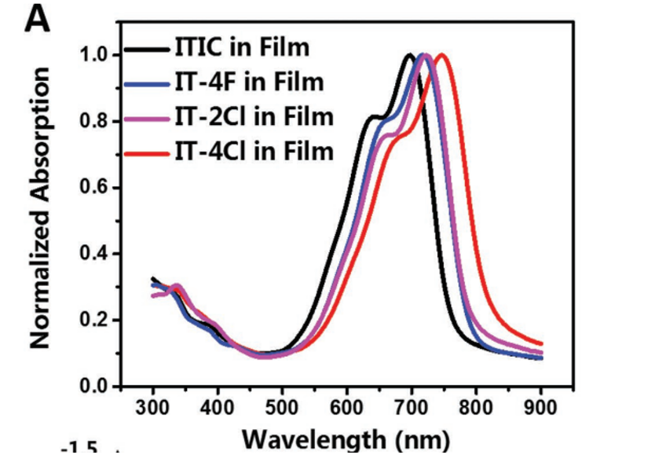
ITIC-4CL:

Slide 7
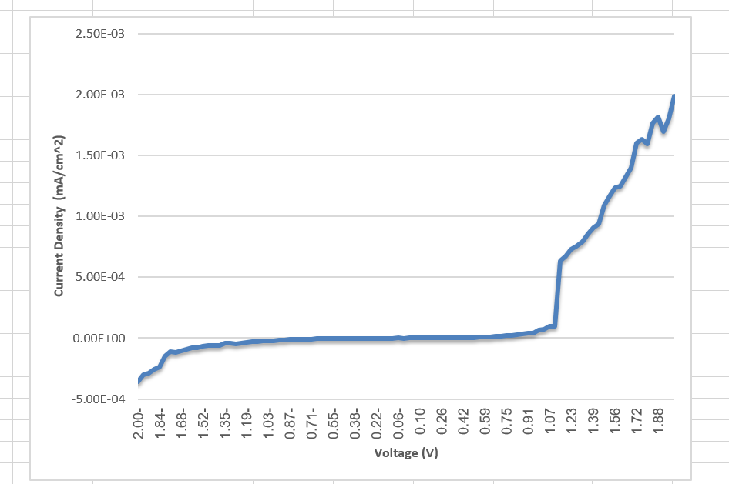
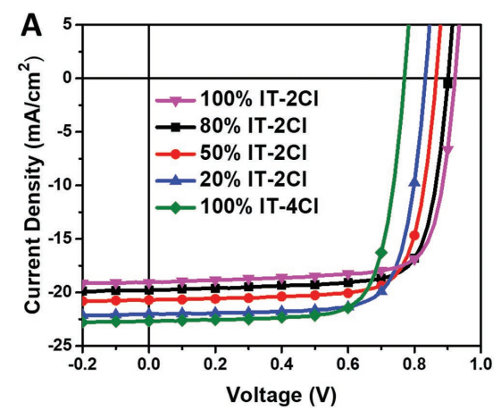
Solar cell J-V curve
In our cell Jsc = -1.06E-07 [mA/cm^2] while in the reference article the Jsc is -22.67 [mA/cm^2].
The difference between these two results is significant and we are aiming to fix this in the future.

Slide 8
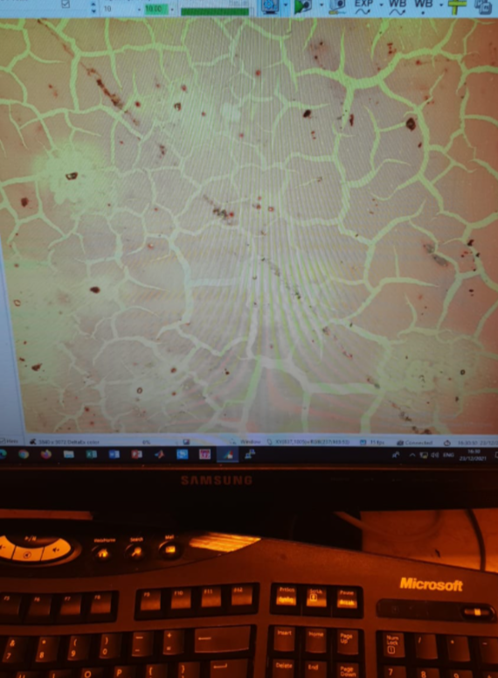
Problems
When we produce our OSCs we got few problems:
First, when we created the active layer we were given that the structure of the layer is
not homogeneous.
The electron buffer layer consists of a material called PEDOT:PSS with a liquid adsorption problem.
The current in our OSCs is seven orders of magnitude lower.

Slide 9
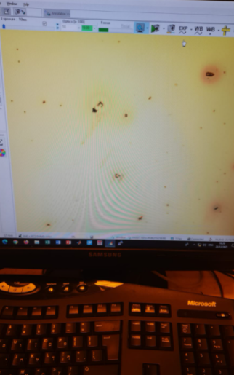
Solutions
We added to our solvent another material by the name of “Diiodooctane” to get homogeneous layer.
We handle liquid adsorption usually by spin-coating and driving out the water by heat.

Slide 10
Conclusions and further objectives
Conclusions:
The absorption measurements of our OSCs is close enough to the measurements of the references article.
The current of our OSCs is very low in relation to the references article.
Further objectives:
In the next few weeks, we need to learn our current problem and find a solution.

